Slide 1
LOC, COCOMO I & COCOMO II

Slide 2
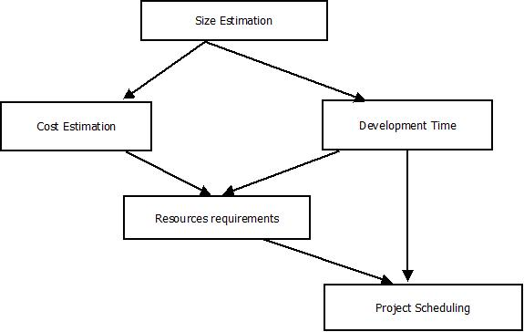
SOFTWARE PLANNING
Software planning begins before technical work starts, continues as the software
Evolves from concept to reality, and culminates only when the software is retired.
Fig:- Activities during software project planning

Slide 3
LINES OF CODE(LOC)
A Line of code is any line of program text that is not a comment or blank line, regardless of the number of statements or fragments on the line. This specifically includes all lines containing program header, declarations, and executable and non-executable statements.
While line of codes have their uses, their usefulness is limited for other tasks like functionality, complexity, efficiency, etc.

Slide 4
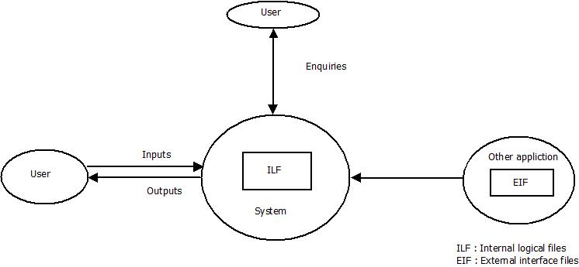
FUNCTION POINT
Function point measures functionality which is a solution to the size measurement problem.
It is decomposed into following functional units
Inputs
Outputs
Enquiries
Internal Logical Files
External Interface Files

Slide 5
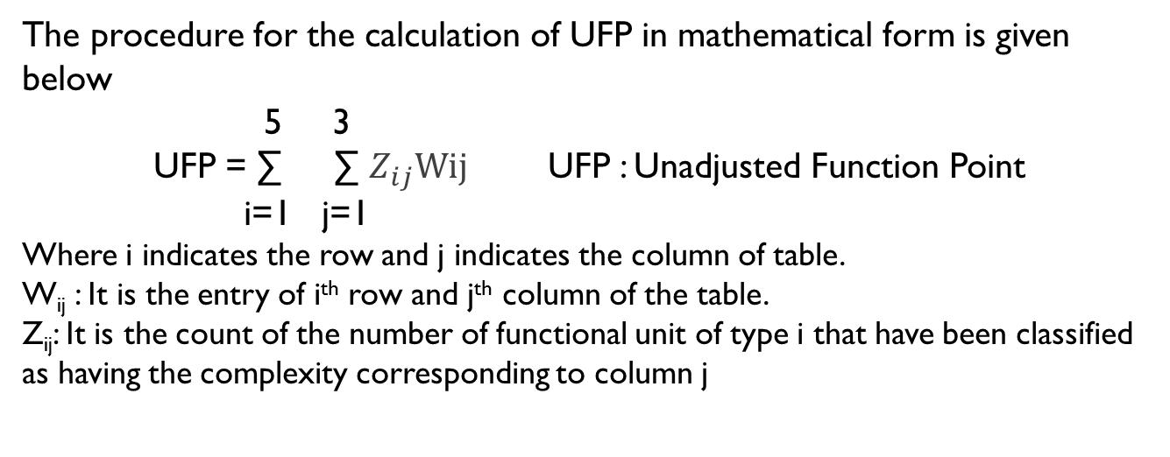
FUNCTIONAL UNITS WITH WEIGHTING FACTORS
Functional units | Low | Average | High
External Inputs | 3 | 4 | 6
External Outputs | 4 | 5 | 7
External Inquiries | 3 | 4 | 5
Internal logical files (ILF) | 7 | 10 | 15
External interface files (EIF) | 5 | 7 | 10
The procedure for the calculation of UFP in mathematical form is given below
5 3
UFP = ∑ ∑ $Z_{ij}Wij$UFP : Unadjusted Function Point i=1 j=1
Where i indicates the row and j indicates the column of table.
W_{ij} : It is the entry of i^{th} row and j^{th} column of the table.
Z_{ij}: It is the count of the number of functional unit of type i that have been classified as having the complexity corresponding to column j

Slide 6
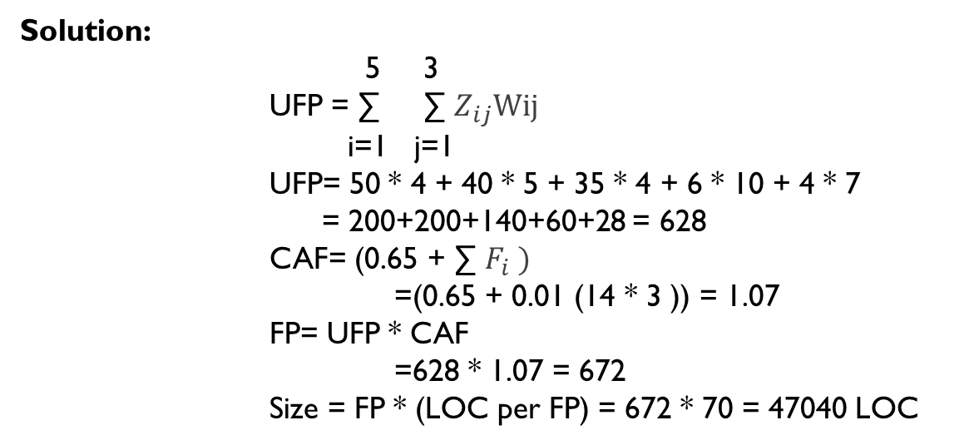
An example
Consider a project with the following functional units: 50 user inputs,40 user outputs, 35 user enquiries,6 user files,4 external interfaces.
Assume all complexity adjustment factors and weighting factors are average.
Compute the function points for the project. Suppose that program needs 70 LOC per FP. Find out the size of complete project.
Solution:
5 3
UFP = ∑ ∑ $Z_{ij}Wij$
i=1 j=1
UFP= 50 * 4 + 40 * 5 + 35 * 4 + 6 * 10 + 4 * 7
= 200+200+140+60+28 = 628
CAF= (0.65 + ∑$F_{i} )$
=(0.65 + 0.01 (14 * 3 )) = 1.07
FP= UFP * CAF
=628 * 1.07 = 672
Size = FP * (LOC per FP) = 672 * 70 = 47040 LOC

Slide 7
Cost Estimation
Approximate judgement of the costs for a project. It should be done throughout the entire life cycle.
Why we need?
To determine how much effort and time a software project requires.
Important for making good management decisions.
It facilitates competitive contract bids.
It affect the planning and budgeting of a project.

Slide 8
Development Mode of S/W Projects
Mode | Project Size | Nature of Project | Innovation | Deadline
Organic | Typically 2-50 KLOC | Small size project, Experienced developers. | Little | Not Tight
Semi Detached | Typically 50-300KLOC | Medium size project and team. | Medium | Medium
Embedded | Typically over 300KLOC | Large project, Real-time systems | Significant | Tight

Slide 9
Constructive Cost Model(COCOMO )
The COCOMO model is a single variable software cost estimation model developed by Barry Boehm in 1981.
The model uses a basic regression formula, with parameters that are derived from historical project data and current project characteristics.
Hierarchy of Cocomo Model
Basic COCOMO model
Intermediate COCOMO model
Detailed COCOMO model

Slide 10
Basic COCOMO Model
It take the form:
Effort(E) = a_{b} * (KLOC)^{b}_{b}(in Person-months)
DevelopmentTime(D) = c_{b} * (E) ^{d}_{b} (in month)
Average staff size(SS) = E/D (in Person)
Productivity(P) = KLOC / E (in KLOC/Person-month)
Project | a_{b} | b_{b} | c_{b} | d_{b}
Organic | 2.4 | 1.05 | 2.5 | 0.38
Semidetached | 3.0 | 1.12 | 2.5 | 0.35
Embedded | 3.6 | 1.20 | 2.5 | 0.32

Slide 11
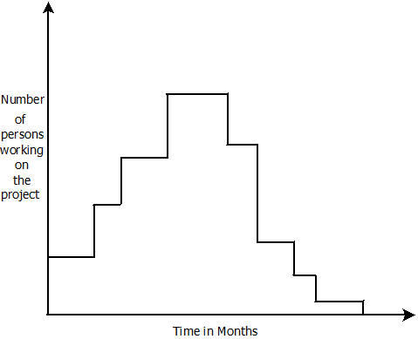
Person-Months
What is Person-Months ? The area under the curve

Slide 12
Basic cocomo: Example
A project size of 200KLOC is to be developed.S/W development team has average experience on similar type of projects.The project schedule is not very tight.Calculate the effort and development time of the project.
Ans: 200 KLOC implies semi-detached mode.
Hence, E= 3.0 * (200)^{1.12} = 1133.12 PM
D=2.5 * (1133.12)^{0.35} = 29.3 M
Avg. staff size(SS) = E/D
= 1133.12/29.3=38.67 Persons.
Productivity (P) = KLOC/E
= 200/1133.12=0.1765 KLOC/PM.

Slide 13
Intermediate COCOMO
Extension of Basic COCOMO
Why Use ?
Basic model lacks accuracy
Computes software development effort as a function of program size and set of 15 Cost Drivers
Cost Driver: A multiplicative factor that determines the effort required to complete the software project.
Why Cost Drivers?
Adjust the nominal cost of a project to the actual project Environment.
For each Characteristics, Estimator decides the scale factor
Very Low
Low
Nominal
High
Very High
Extra High

Slide 14
Cost Drivers
Product Attributes
Required Software Reliability (RELY)
Personnel Attributes
Analyst Capability (ACAP)
Application Experience (AEXP)
Database Size (DATA)
Project Attributes
Modern programming practices (MODP)
Use of Software tools (TOOL)
Computer turnaround time (TURN)
Execution Time Constraint (TIME)
Computer Attributes
Product Complexity (CPLX)
Main Storage constraint (STOR)
Virtual Machine volatility (VIRT)
Programmer Capability (PCAP)
Virtual Machine Experience (VEXP)
Programming language Experience (LEXP)
Required development schedule (SCED)

Slide 15
The Calculation
Multiply all 15 Cost Drivers to get Effort Adjustment Factor(EAF)
E(Effort) = a_{b}(KLOC)^{b}b * EAF(in Person-Month)
D(Development Time) = c_{b}(E)^{d}b (in month)
SS (Avg Staff Size) = E/D (in persons)
P (Productivity) = KLOC/E (in KLOC/Person-month)
Project | a_{b} | b_{b} | c_{b} | d_{b}
Organic | 3.2 | 1.05 | 2.5 | 0.38
Semidetached | 3.0 | 1.12 | 2.5 | 0.35
Embedded | 2.8 | 1.20 | 2.5 | 0.32

Slide 16
Intermediate COCOMO : Example
A new project with estimated 400 KLOC embedded system has to be developed. Project manager hires developers of low quality but a lot of experience in programming language. Calculate the Effort, Development time, Staff size & Productivity.
EAF = 1.29 * 0.95 = 1.22
400 LOC implies Embedded System
Effort = 2.8*(400)^{1.20} * 1.225 = 3712 * 1.22 = 4528 person-months
Development Time = 2.5 * (4528)^{0.32} = 2.5 * 14.78 = 36.9 months
Avg. Staff Size = E/D = 4528/36.9 = 122 persons
Productivity = KLOC/Effort = 400/4528 = 0.0884 KLOC/person-month
Cost Drivers | Very Low | Low | Nominal | High | Very High | Extra High
AEXP | 1.29 | 1.13 | 1.00 | 0.91 | 0.82 | --
LEXP | 1.14 | 1.07 | 1.00 | 0.95 | -- | --

Slide 17
Detailed COCOMO
Detailed COCOMO = Intermediate COCOMO + assessment of Cost Drivers impact on each phase.
Phases
Plans and requirements
System Design
Detailed Design
Module code and test
Integrate and test
Cost of each subsystem is estimated separately. This reduces the margin of error.

Slide 18
The Calculation
Multiply all 15 Cost Drivers to get Effort Adjustment Factor(EAF)
E(Effort) = a_{b}(KLOC)^{b}b * EAF(in Person-Month)
D(Development Time) = c_{b}(E)^{d}b (in month)
E_{p} (Total Effort) = µ_{p} * E (in Person-Month)
D_{p} (Total Development Time) = τ_{p} * D (in month)
Ref: Software Engineering By K.K.Aggarwal & Y. Singh Created by: Kalyan Mondal

Slide 19
Detailed COCOMO : Example
Consider a project to develop a full screen editor. The major components identified and their sizes are (i) Screen Edit – 4K (ii) Command Lang Interpreter – 2K (iii) File Input and Output – 1K (iv) Cursor movement – 2K (v) Screen Movement – 3K. Assume the Required software reliability is high, product complexity is high, analyst capability is high & programming language experience is low. Use COCOMO model to estimate cost and time for different phases.
Size of modules : 4 + 2 + 1 + 2 + 3 = 13 KLOC [Organic]
EAF = 1.15 * 1.15 * 0.86 * 1.07 = 1.2169
Cost Drivers | Very Low | Low | Nominal | High | Very High | Extra High
RELY | 0.75 | 0.88 | 1.00 | 1.15 | 1.40 | --
CPLX | 0.70 | 0.85 | 1.00 | 1.15 | 1.30 | 1.65
ACAP | 1.46 | 1.19 | 1.00 | 0.86 | 0.71
LEXP | 1.14 | 1.07 | 1.00 | 0.95 | -- | --
Ref: Software Engineering By K.K.Aggarwal & Y. Singh Created by: Kalyan Mondal

Slide 20
Example (Contd.)
Initial Effort (E) = a_{b}(KLOC)^{b}b * EAF = 3.2*(12)^{1.05} * 1.2169 = 52.9 person-months
Initial Development Time = c_{b}(E)^{d}b =2.5*(52.9)^{0.38} = 11.29 months
Phase value of µ_{p} and τ_{p}
Phase wise effort & development time distribution
 | Plan & Req^{r} | System Design | Detail Design | Module code & test | Integration & Test
Organic Small µ_{p} | 0.06 | 0.16 | 0.26 | 0.42 | 0.16
Organic Small τ_{p} | 0.10 | 0.19 | 0.24 | 0.39 | 0.18
 | E | D | Ep (in person-months) | Dp (in months)
Plan & Requirement | 52.9 | 11.29 | 0.06*52.9 = 3.17 | 0.10*11.29=1.12
System Design | 52.9 | 11.29 | 0.16*52.9=8.46 | 0.19*11.29=2.14
Detail Design | 52.9 | 11.29 | 0.26*52.9=13.74 | 0.24*11.29=2.70
Module code & test | 52.9 | 11.29 | 0.42*52.9=22.21 | 0.39*11.29=4.40
Integration & test | 52.9 | 11.29 | 0.16*52.9=8.46 | 0.18*11.29=2.03
Ref: Software Engineering By K.K.Aggarwal & Y. Singh Created by: Kalyan Mondal

Slide 21
WHY COCOMO-II ?
The changes in s/w development techniques included a move away from mainframe overnight batch processing to desktop-based real-time turnaround.
These changes and others began to make applying the original COCOMO model problematic.
The model is tuned to the life cycle practices of the 21st century.

Slide 22
Categories Identified By Cocomo II
End User Programming
Infrastructure Sector
Intermediate Sectors
Application Generators And Composition Aids
Application Composition Sector
System Integration
Stages Of Cocomo-II
Application Composition
Earlier Design
Post Architecture

Slide 23
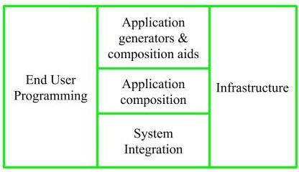
Sub-models

Slide 24
1. End User Programming: Application generators are used in this sub-model. End user write the code by using these application generators. Example – Spreadsheets, report generator, etc.

Slide 25
2. Intermediate Sector:
(a). Application Generators and Composition Aids – This category will create largely prepackaged capabilities for user programming. Their product will have many reusable components. Typical firms operating in this sector are Microsoft, Lotus, Oracle, IBM, Borland, Novell.
(b). Application Composition Sector – This category is too diversified and to be handled by prepackaged solutions. It includes GUI, Databases, domain specific components such as financial, medical or industrial process control packages.
(c). System Integration – This category deals with large scale and highly embedded systems.

Slide 26
3. Infrastructure Sector: This category provides infrastructure for the software development like Operating System, Database Management System, User Interface Management System, Networking System, etc.

Slide 27
Stage-I:
It supports estimation of prototyping. For this it uses Application Composition Estimation Model. This model is used for the prototyping stage of application generator and system integration.
Stage-II:
It supports estimation in the early design stage of the project, when we less know about it. For this it uses Early Design Estimation Model. This model is used in early design stage of application generators, infrastructure, system integration.
Stage-III:
It supports estimation in the post architecture stage of a project. For this it uses Post Architecture Estimation Model. This model is used after the completion of the detailed architecture of application generator, infrastructure, system integration.

Slide 28
COCOMO I | COCOMO II
COCOMO I is useful in the waterfall models of the software development cycle. | COCOMO II is useful in non-sequential, rapid development and reuse models of software.
It provides estimates of effort and schedule. | It provides estimates that represent one standard deviation around the most likely estimate.
This model is based upon the linear reuse formula. | This model is based upon the non linear reuse formula
This model is also based upon the assumption of reasonably stable requirements. | This model is also based upon reuse model which looks at effort needed to understand and estimate.
Effort equation’s exponent is determined by 3 development modes. | Effort equation’s exponent is determined by 5 scale factors.
Development begins with the requirements assigned to the software. | It follows a spiral type of development.
Number of submodels in COCOMO I is 3 and 15 cost drivers are assigned | In COCOMO II, Number of submodels are more and 17 cost drivers are assigned
Size of software stated in terms of Lines of code | Size of software stated in terms of Object points, function points and lines of code

